Slide 1
-: Online booking for Theatre Hall Ticket :- IT’S SHOW TIME
GROUP NO:- 13

Slide 2
Languages used:
Front end:
CSS, HTML 5.0, JavaScript
Back end:
MySQL, PHP

Slide 3
Name:- Priyanshu S. Rana
E_no:- 196040307057
E-mail:- priyanshurana2228@gmail.com
Phone_no:-9016276879
Name:- Gitanjali N. Ramiya
E_no:- 196040307014
E-mail:- gitanjaliramiya0905@gmail.com
Phone_no:-8980821422
Name:- Dwij A. Patel
E_no:- 196040307039
E-mail:- dwijpatel1704@gmail.com
Phone_no:-8849259341
Guided by:- P.M.Tank Sir.

Slide 4
Abstract:-
Main purpose:-
Being able to check shows, movies, hall, time, and location easily through online mode.
Also book and cancel the ticket at our own convenience whenever we want.
About our website:-
What does it display: movies running currently, available shows, time of show, available seats in that particular show and the cost of seat.
As per the screens, various type Of seats are available For example, screen 1 has seat with push back, Screen 2 has seats with push back and leg support and screen 3 provides with bed seat.
Can easily see the shows and book any number of available seats from this online website.
The customer has to pay the amount through any kind of online payment through any app like paytm, or phonepay.
How this website works: It is simple to use. The customer has to open the website, enter the login details, Explore the movies, shows, time, and location depending on their need. After seeing all the available shows, the customer needs to make the choice by clicking beside it.

Slide 5
Numbers of users:-
Customer (the person who books the ticket).
Theatre Webmaster( someone who takes care of the website, update the new data, and is responsible for making the necessary changes or edits).
Advantages of using this website
It provides with convenience to the customer to get the information and book whatever he/she wants from any place.
Saves time, as the customer need not travel all the way long to the cinema hall to check any show or book.
Easier and faster payment as the method of payment is online through apps like googlepay, phonepay and paytm.
Gives facility to the customer to book a show in advance.

Slide 6
Requirements:-
User point of view function :-
Easy to book any number of tickets.
View the movies ongoing.
Book the show.
Online payment can be done.
Theatre point of view function:-
Addition and removal of movies and shows
Updates of seats and screens available.
Billing.

Slide 7
Functions and working:-
User point of view :
Tab 1 :
This tab is the first tab, which displays the cover page of the website.
This tab includes the login on the customer who wants to book the show, and displays the recent movies
The login details will include: contact detail- email and phone number.
Username and password.
Tab 2 :
This tab contains the movies that are running on the screens at the moment.
Here, the customer will be selecting the movie that they want to watch.
The screen will be selected as per the movie running in the corresponding screen.
Tab 3 :
This tab will be displaying the number of available seats for the customer to book.
Here, the customer can book the seats according to their choices
Before finalising, confirming the seats.

Slide 8
Tab 4 :
After the calculation of total number of the seats and the movie selected, the total amount will be displayed with the description.
The cost will depend upon the screen they are going to watch in.
The bottom of this tab will contain the online billing payment details and the amount can be paid .
Theatre Webmaster point of view :
Tab 1 :
This tab is the first tab, which displays the login details of the admin (webmaster)
This includes on the username and the password.
Tab 2 :
Here, the alteration of the movie displayed is done.
The old movies are removed which no longer is in the market.
And the newly launched movies are added for the customers to book.

Slide 9
Tab 3 :
The webmaster will have to be a bit active in this section, adds and removes shows.
The webmaster, updates every details of the shows and movies.

Slide 10
ER DIAGRAM:-
Entity sets and attributes:-
Entity Set | Attributes
Seat | seatid, seatno , row_no, col_no
movie | M_no, m_name, m_dimension, m_language, m_time
Admin | aid, aname, a_cont_no, a_email, a_pass
T_Acc | T_acc_no, T_acc_IFSC, UPI_ID
Show | s_id, s_no, screen_no, type_of_seat, price, s_time, s_date
Customer | cid, cname, c_cont_no, c_email, c_pass
Bill | b_no, b_date, b_time, total_price
Contact_Us | cont_id, cont_name, cont_email, cont_mssg

Slide 11
Associations:-
 | Seat | movie | Admin | T_Acc | Show | Customer | Bill | Contact_Us
Seat | - | - | - | - | * | - | *
movie | - | - | - | - | * | - | -
Admin | - | - | - | - | - | - | -
T_Acc | - | - | - | - | - | - | -
Show | * | * | - | - | - | - | *
Customer | - | - | - | - | - | - | * | *
Bill | * | - | - | - | * | * | -
Contact_Us | - | - | - | - | - | * | - | -

Slide 12
Relationship set:-
Entity sets | Relationship set | Mapping cardinality
Seat-Show | Showseat | Many to many
Seat-Bill | Sbill | Many to many
Movie-Show | MShow | One to many
Show-Bill | ShBill | One to many
Customer-Bill | CBill | One to many
Contact_Us | C_Cont_Us | One to many

Slide 13
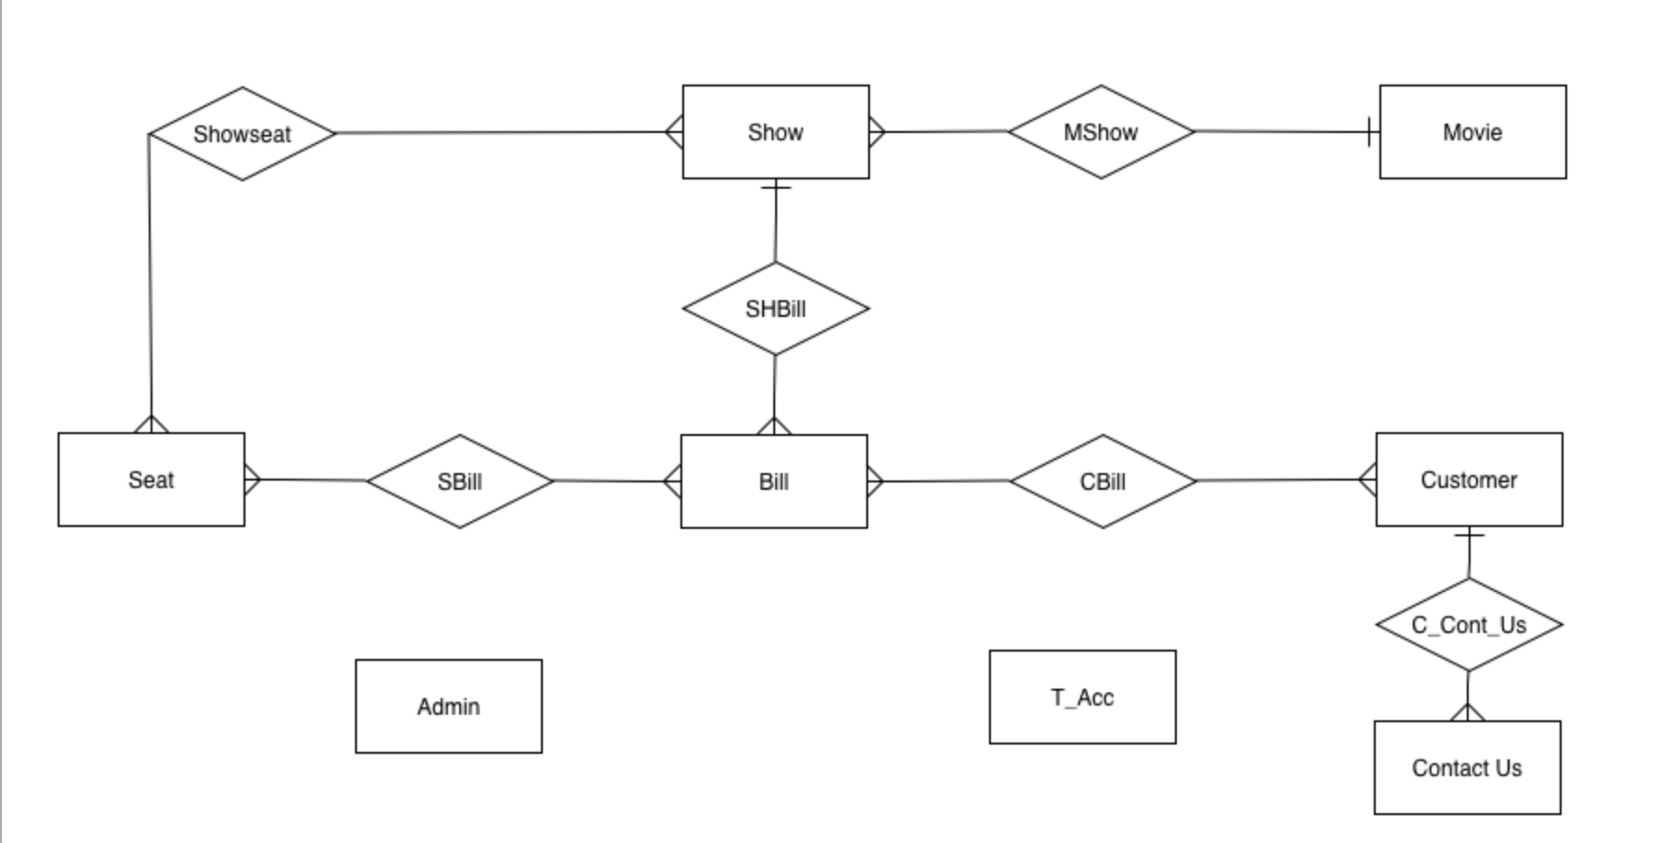
Diagram:-

Slide 14
Relationship set (Derived from ER-D):-
Entity Set | Attributes
Seat | seatid, seatno , row_no, col_no
Customer | cid, cname, c_cont_no, c_email, c_pass
Admin | aid, aname, a_cont_no, a_email, a_pass
T_Acc | T_acc_no, T_acc_IFSC, UPI_ID
Show | s_id, s_no, screen_no, type_of_seat, price, s_time, s_date
Movie | m_no, m_name, m_dimension, m_language, m_time, s_id
Bill | b_no, b_date, b_time, total_price, cid ,sid
Showseat | s_id, seatid, status
Sbill | seatid, b_no
Contact_Us | cont_id, cont_name, cont_email, cont_mssg

Slide 15
Seat:-
Data Dictionary:-
Col-name | Type | Size | Constraint | Represents
Seatid | CHAR | 5 | PRIMARY KEY | Seat Id
Seatno | VARCHAR2 | 4 | NOT NULL | Seat No.
Row_No | CHAR | 2 | NOT NULL | Row No.
Col_No | NUMBER | 2 | NOT NULL | Column No.

Slide 16
Customer:-
Col-name | Type | Size | Constraint | Represents
cid | CHAR | 10 | PRIMARY KEY | Customer Id
cname | CHAR | 20 | NOT NULL | Customer Name
c_cont_no | VARCHAR2 | 20 | NOT NULL | Customer Contact No
c_email | VARCHAR2 | 30 | NOT NULL | Customer Email
c_pass | VARCHAR2 | 15 | NOT NULL | Customer Password

Slide 17
Admin:-
Col-name | Type | Size | Constraint | Represents
aid | CHAR | 10 | PRIMARY KEY | Admin Id
aname | CHAR | 20 | NOT NULL | Admin Name
a_cont_no | VARCHAR2 | 20 | NOT NULL | Admin Contact No
a_email | VARCHAR2 | 30 | NOT NULL | Admin Email
a_pass | VARCHAR2 | 15 | NOT NULL | Admin Password

Slide 18
T_Acc:-
Col-name | Type | Size | Constraint | Represents
T_acc_no | VARCHAR2 | 20 | PRIMARY KEY | Account no
T_acc_IFSC | VARCHAR2 | 20 | NOT NULL | IFSC
UPI_ID | VARCHAR2 | 20 | NOT NULL | UPI ID

Slide 19
Show:-
Col-name | Type | Size | Constraint | Represents
s_id | CHAR | 10 | PRIMARY KEY | Show Id
s_no | CHAR | 20 | NOT NULL | Show No
screen_no | VARCHAR2 | 20 | NOT NULL | Screen No
type_of_seat | CHAR | 30 | NOT NULL | Type Of Seat
price | VARCHAR2 | 15 | NOT NULL | Price
s_time | VARCHAR2 | 10 | NOT NULL | Show Time
s_date | DATE | 15 | NOT NULL | Show Date

Slide 20
Movie:-
Col-name | Type | Size | Constraint | Represents
m_no | VARCHAR2 | 10 | PRIMARY KEY | Movie No
m_name | CHAR | 30 | NOT NULL | Movie Name
m_dimension | VARCHAR2 | 10 | NOT NULL | Movie Dimention
m_language | CHAR | 30 | NOT NULL | Movie Language
m_time | VARCHAR2 | 15 | NOT NULL | Movie Time
s_id | CHAR | 10 | FOREIGN KEY | Show Time

Slide 21
Bill:-
Col-name | Type | Size | Constraint | Represents
b_no | CHAR | 10 | PRIMARY KEY | Bill No
b_date | DATE | 10 | NOT NULL | Bill Date
b_time | VARCHAR2 | 10 | NOT NULL | Bill Time
total_price | VARCHAR2 | 10 | NOT NULL | Total Price
cid | CHAR | 10 | FOREIGN KEY | Customer Id
s_id | CHAR | 10 | FOREIGN KEY | Show Time

Slide 22
Showseat:-
Col-name | Type | Size | Constraint | Represents
s_id | CHAR | 10 | FOREIGN KEY | Show Id
Seatid | CHAR | 5 | FOREIGN KEY | Seat Id
status | CHAR | 20 | NOT NULL | Seat status
Sbill:-
Col-name | Type | Size | Constraint | Represents
Seatid | CHAR | 5 | FOREIGN KEY | Seat Id
b_no | CHAR | 10 | FOREIGN KEY | Bill No

Slide 23
Contact Us:-
Col-name | Type | Size | Constraint | Represents
cont_id | INT | 11 | PRIMARY KEY | Contact id
cont_name | CHAR | 30 | NOT NULL | Customer Contact Name
cont_email | VARCHAR | 50 | NOT NULL | Customer Contact Email
cont_mssg | TEXT | - | NOT NULL | Customer Contact Message
cid | CHAR | 10 | PRIMARY KEY | Customer Id

Slide 24
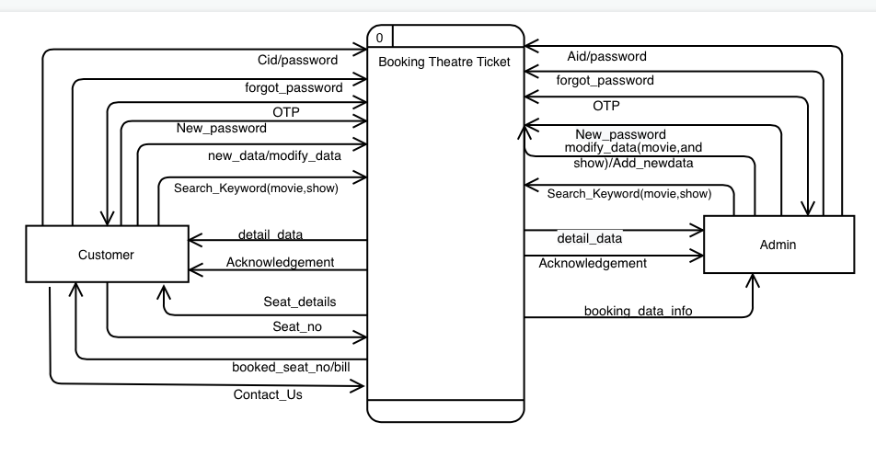
Data Flow Diagram:-
Level 0(Context Level):

Slide 25
For customer:
new_data/modification data: The customer can enter new data. The customer will be able to add, remove, edit customer data.
search_keyword: The customer can search for available movies, shows, timings and available seats.
For Admin:
new_data/modification data: The admin can enter new data. The admin will be able to add, remove or edit data related to movies, shows, and seats.
search_keyword: The admin can search for the movies, shows, and available seats displayed and the bookings done so far.

Slide 26
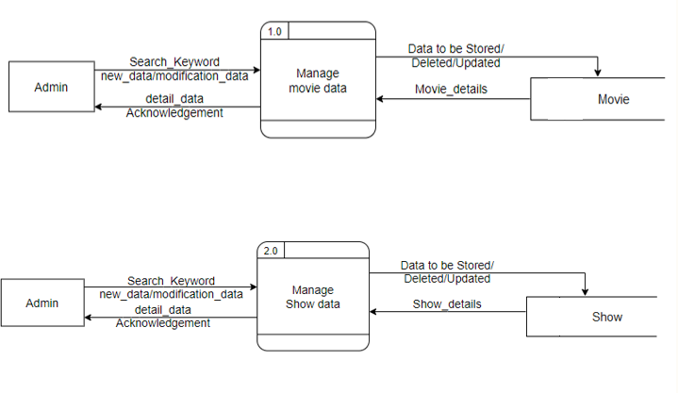
Level 1:

Slide 27
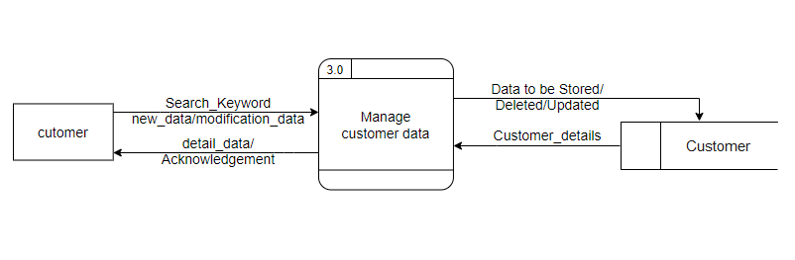
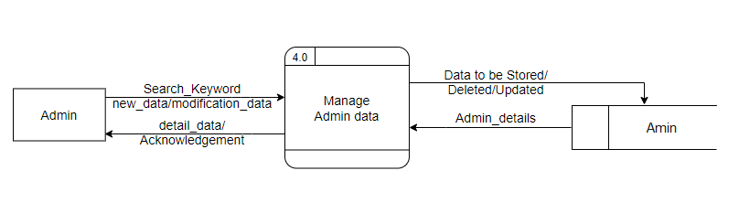

Slide 28
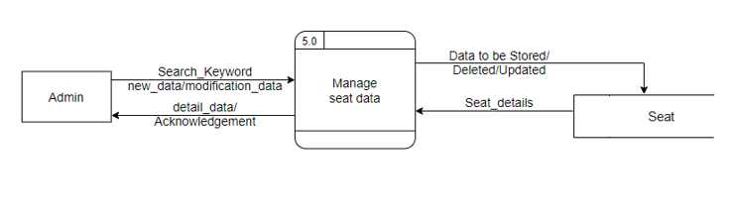

Slide 29
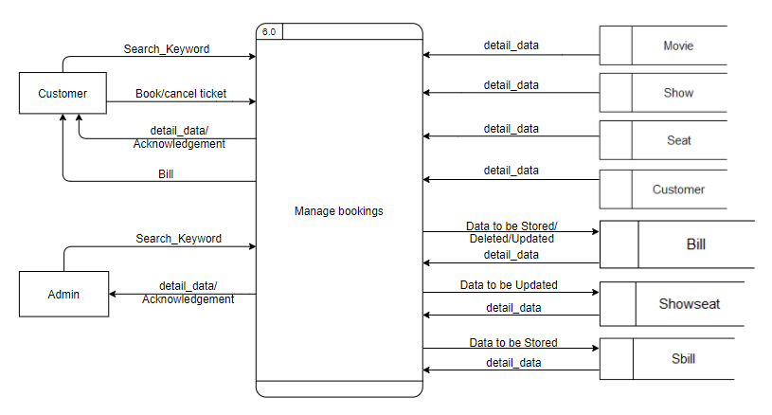

Slide 30
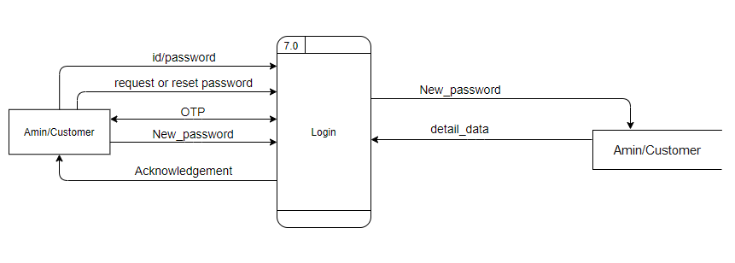

Slide 31
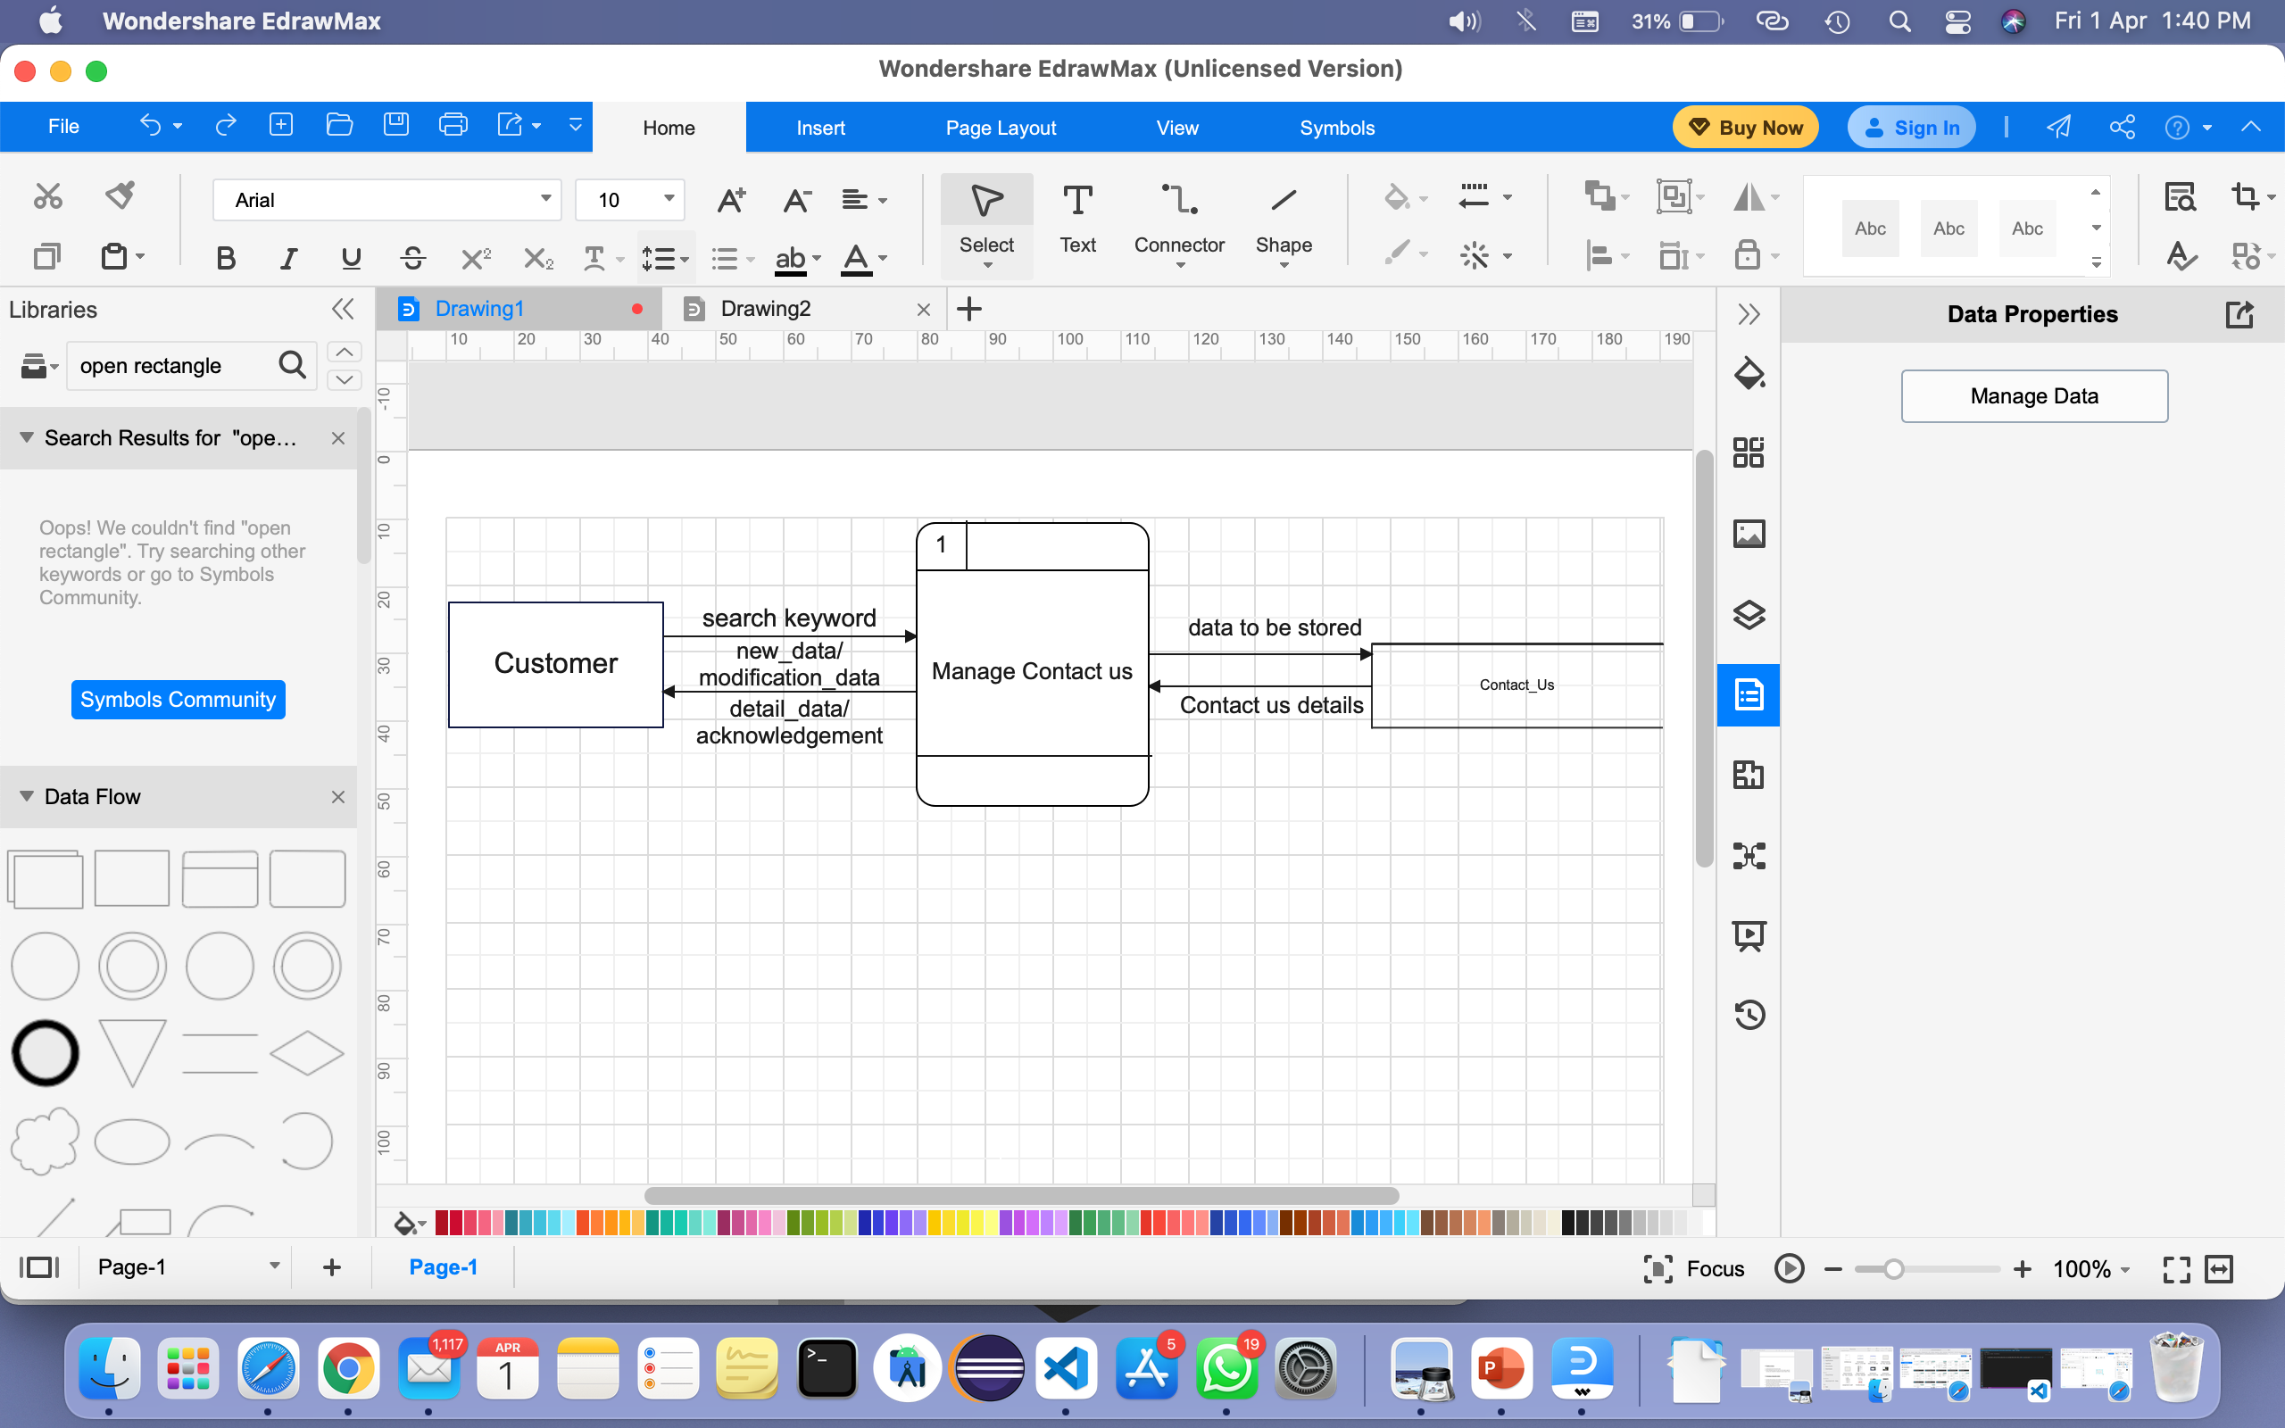
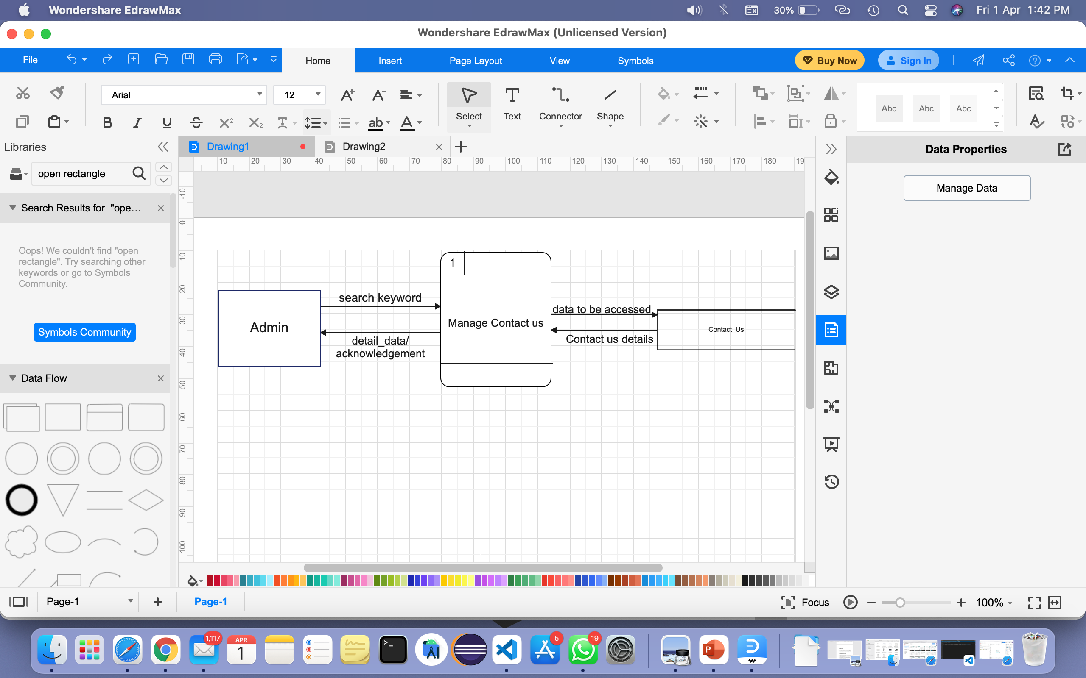

Slide 32
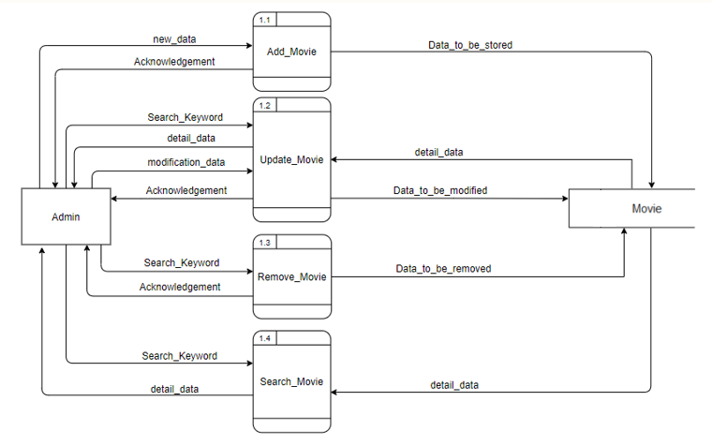
Level 2:
Level 2:

Slide 33
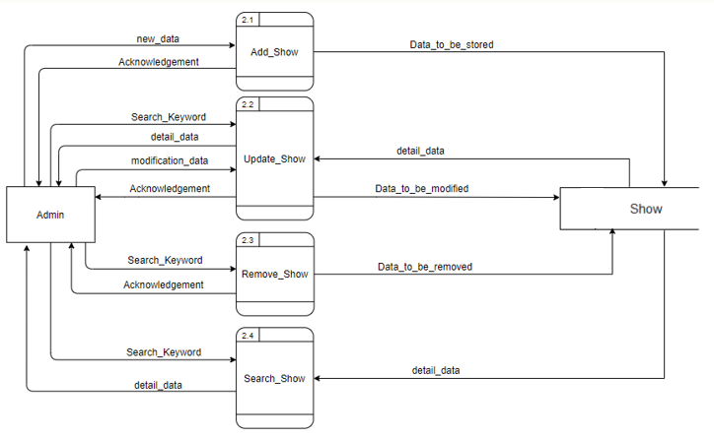

Slide 34
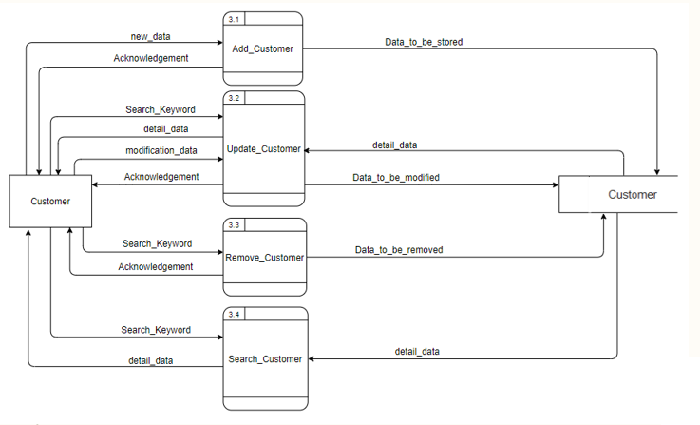

Slide 35
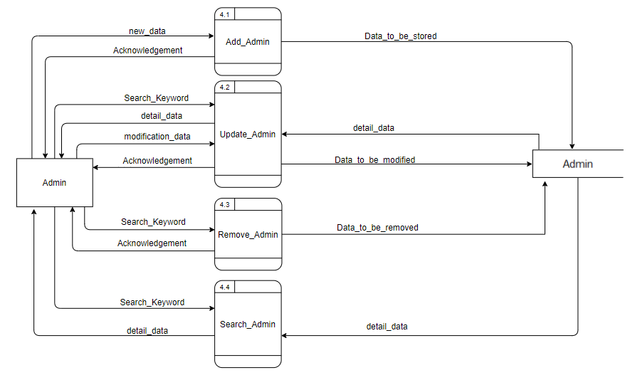

Slide 36
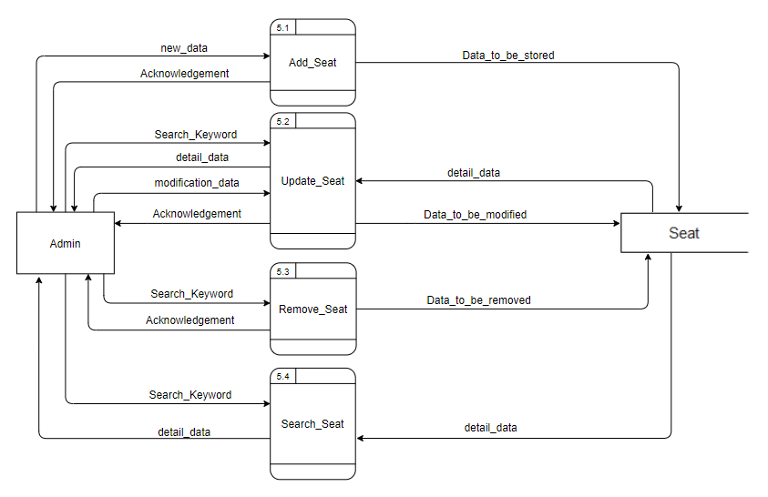

Slide 37
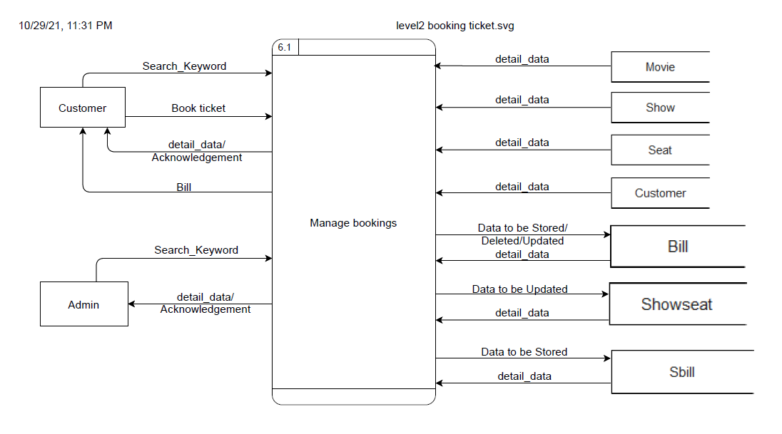

Slide 38
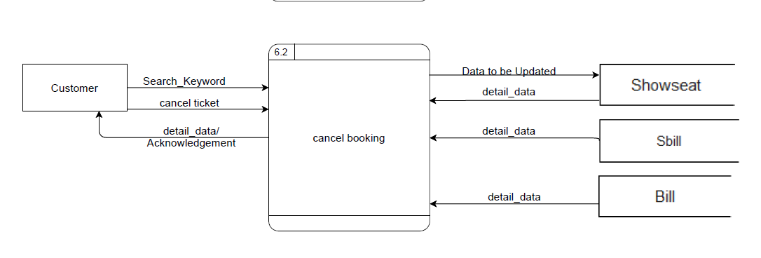
Customer:
Search_keyword: the customer will be able to search data regarding movies, shows and seats then proceed with bookings.
Admin:
Search_keyword: the admin will be able to search about the bookings done by customer.

Slide 39
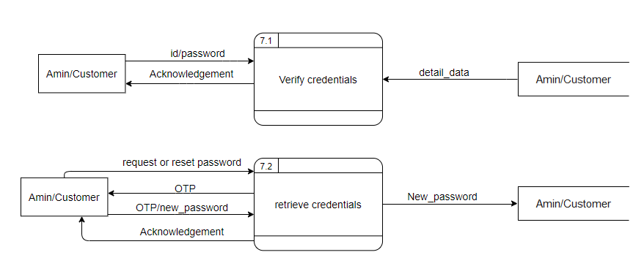

Slide 40
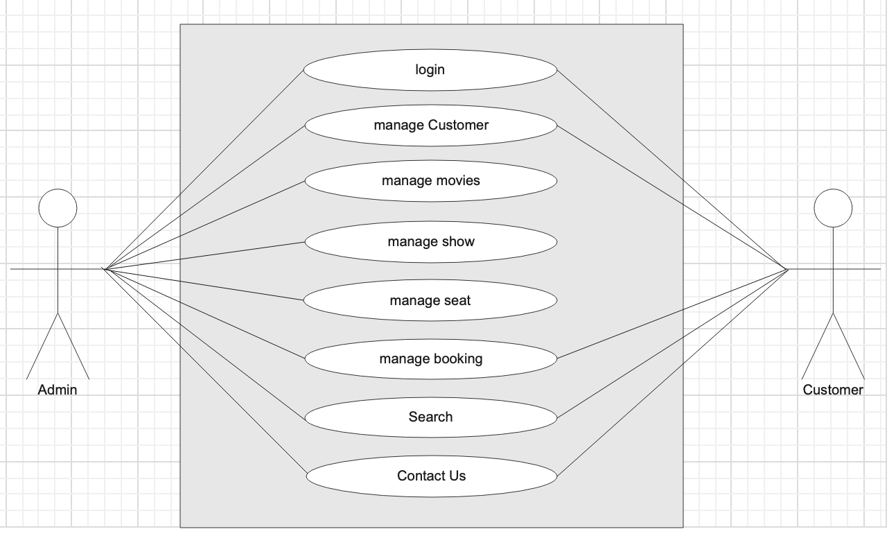
Use Case Diagram:

Slide 41
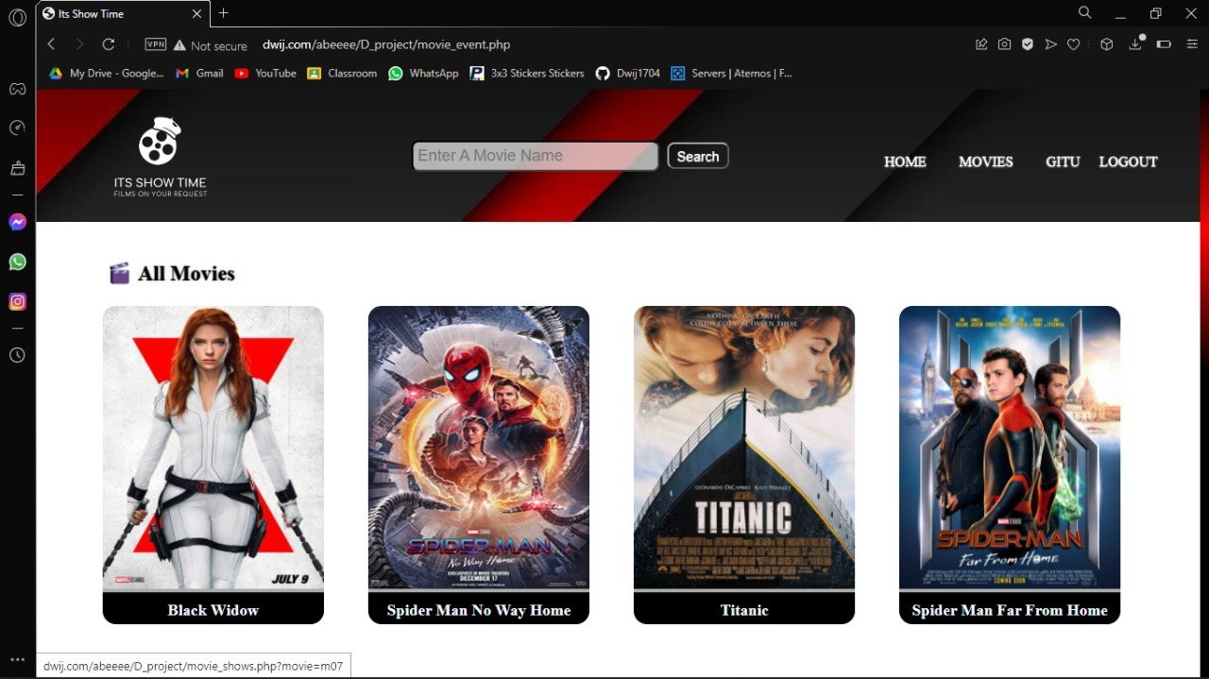
Pictorial Representation:
Customer Panel

Slide 42
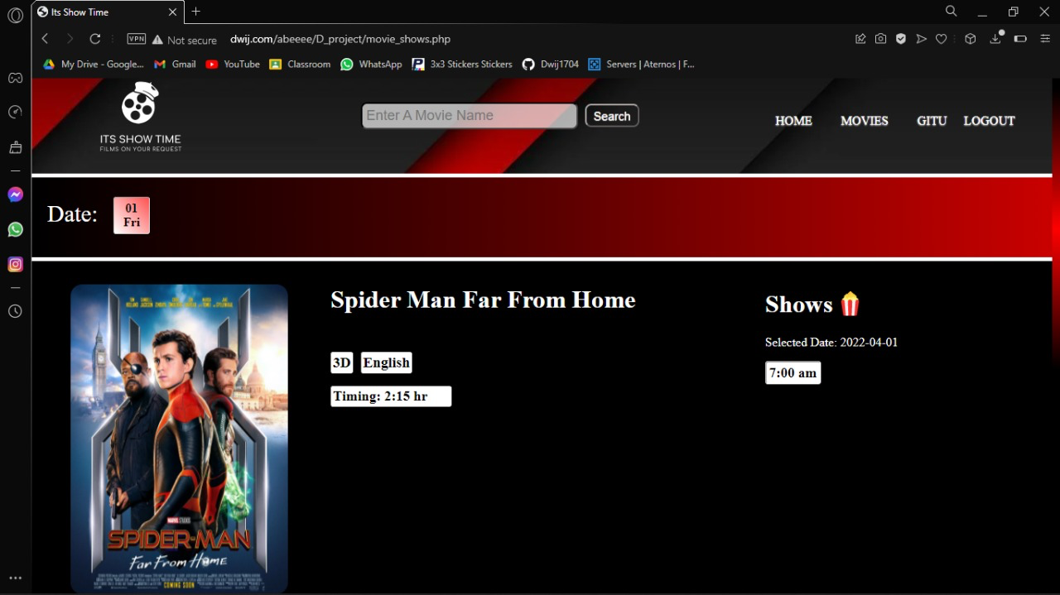

Slide 43
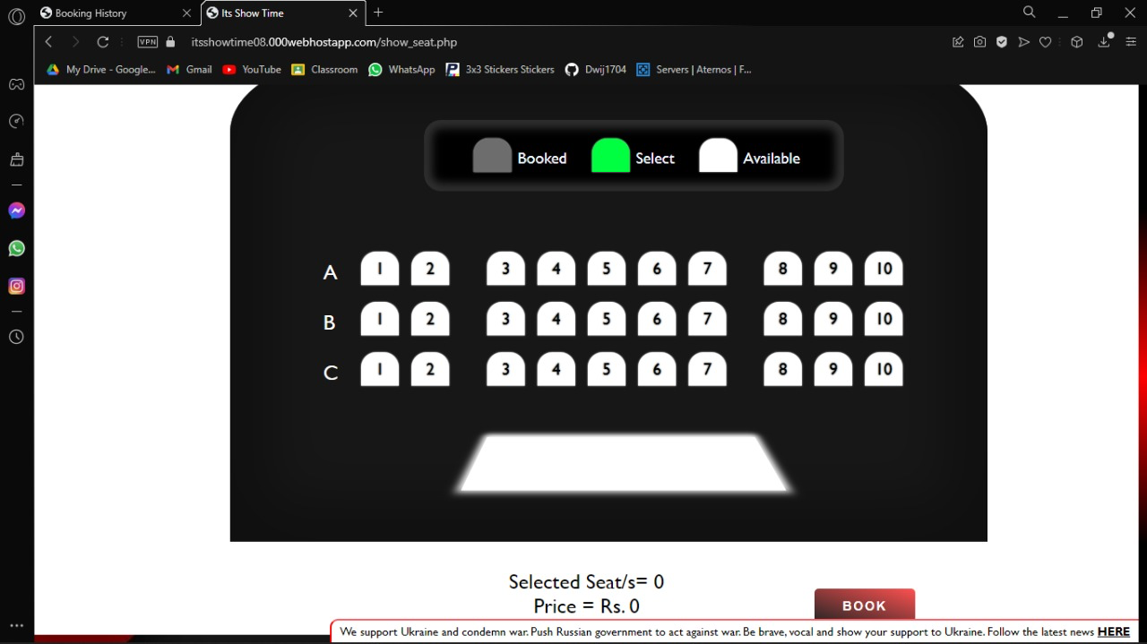

Slide 44
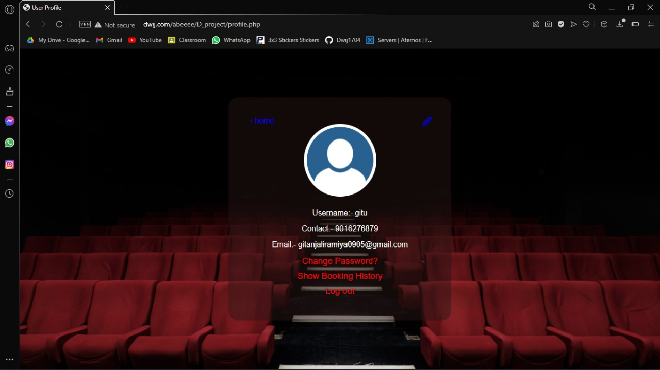

Slide 45
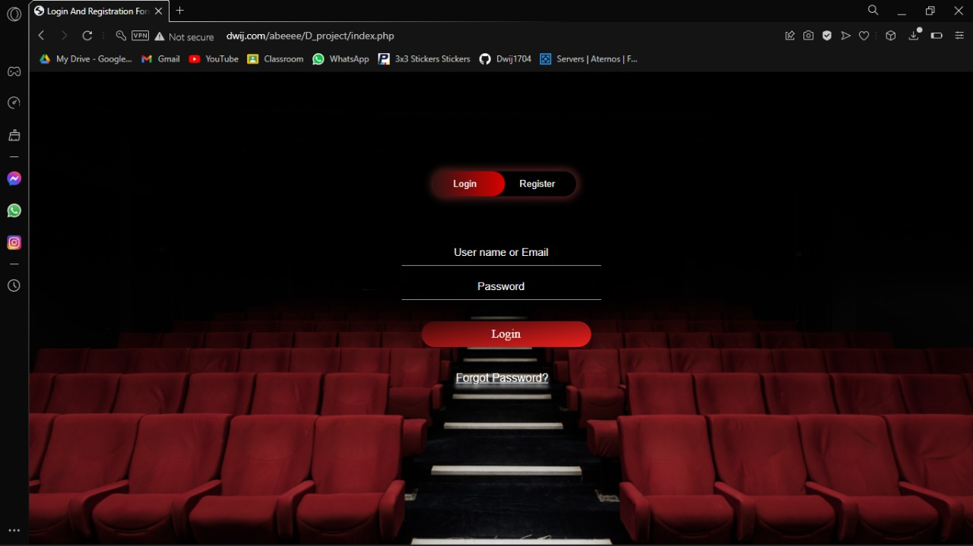

Slide 46
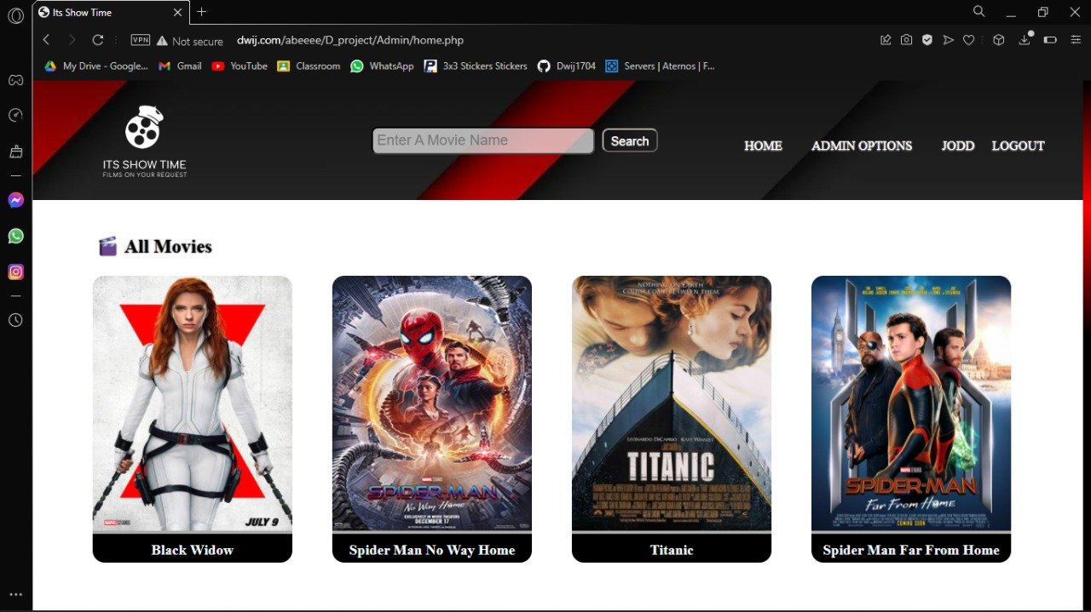
Admin Panel:

Slide 47
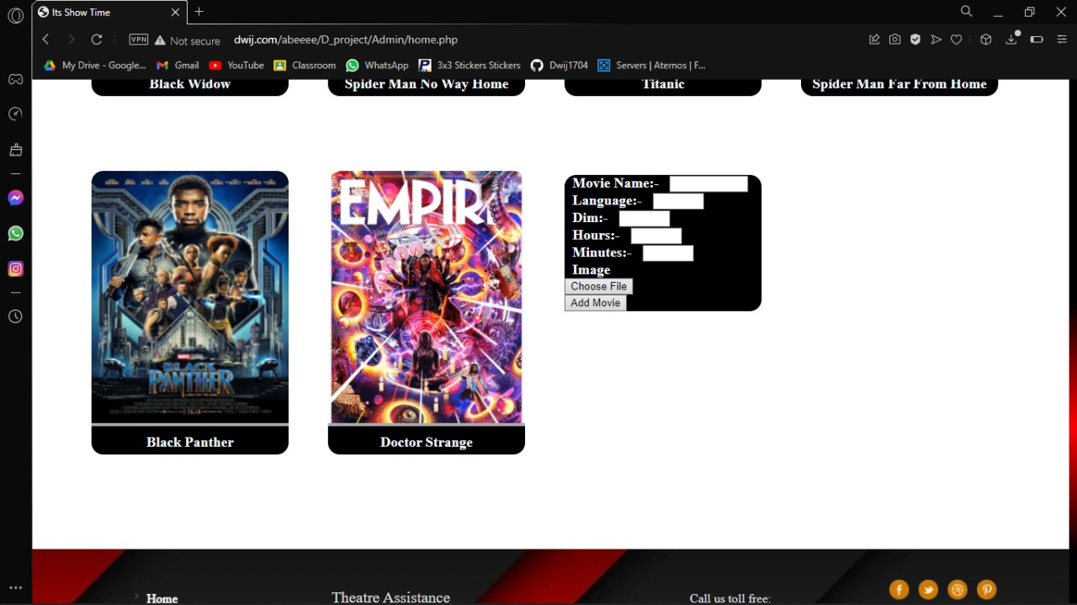

Slide 48
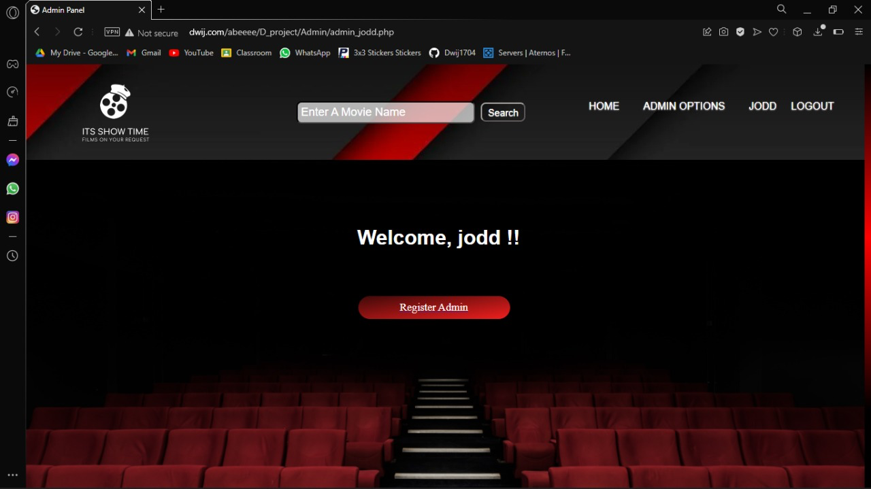

Slide 49
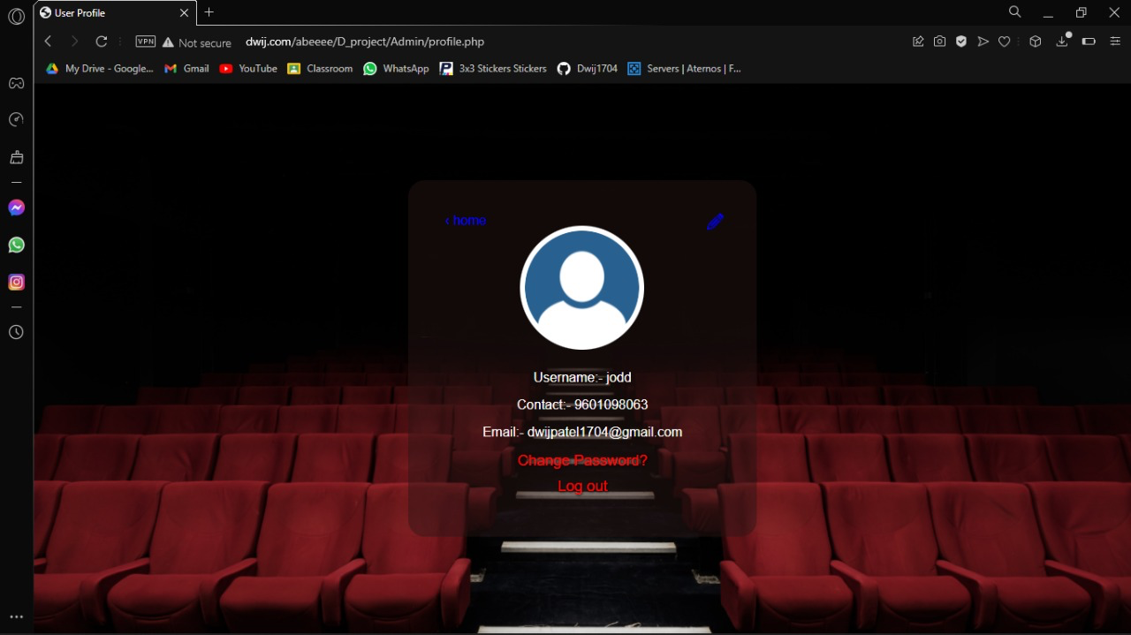

Slide 50
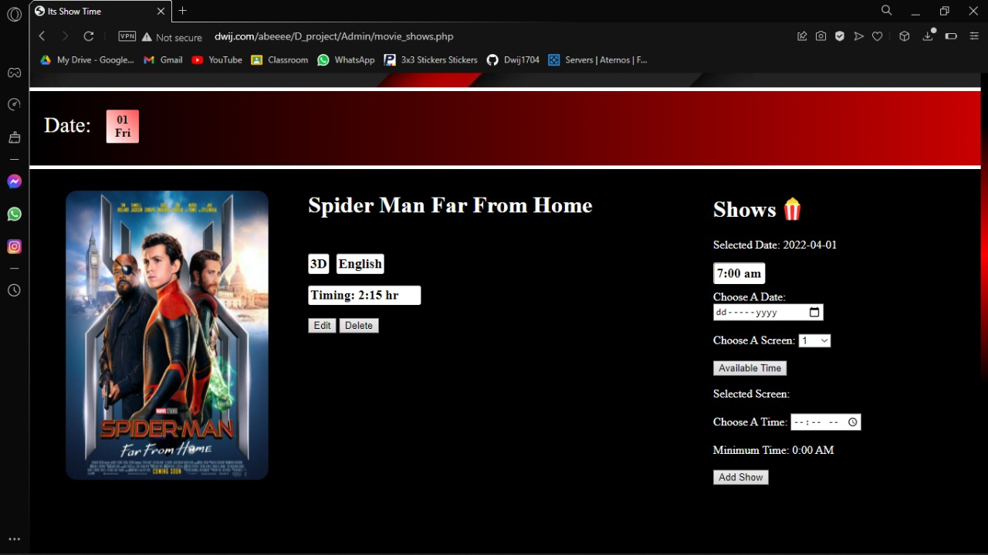

Slide 51
Conclusion:
This project has provided us with vast range of knowledge regarding databases, data flow diagram and use case diagrams.
It has given us the training on how to work with different levels of diagrams.
Apart from learning, we have had a great time with teachers as they have given full support with any problem that we had.
We are hoping that this will definitely be very useful for future use by the people.

Slide 52
Thank you

